Slide 1



Lesson1: Hello!
1. Meeting new people.
2. Classroom Language.
3. The Alphabet. ABC
Notes:
Learning Objectives Students will …
• use friendly greetings and introduce themselves
• follow basic classroom directions: Listen, Look, Write, Draw, Open your book, Sit down.
• identify and write alphabet letters
• identify and use numbers 1-10
• identify and use the days of the wee

Slide 3
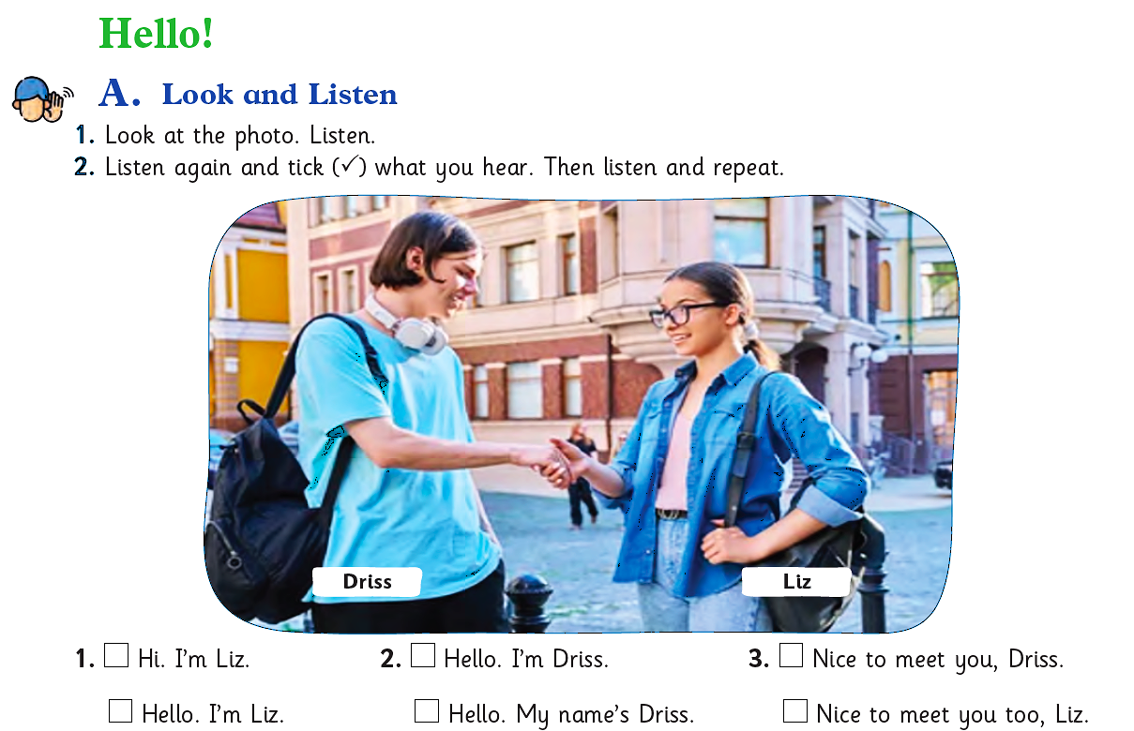

Notes:
1. Stand at the front of the room, smile and wave and say, Hello! in a friendly voice.
Repeat, Hello!, then gesture (hold a hand up to your ear) and wait for students to say “Hello!” back to you.
Repeat until the whole class responds chorally. Then say, Welcome to English!
Walk around the room, stopping at some individual students’ desks, saying, “Hello.” and having them respond.
2. Point out the photo. Give students a moment to think silently about who the people are (students, friends) and imagine what they are saying.
Read the directions aloud. Ask students to pay attention to how they give their names.
3. Read the direction aloud. Model “tick” by writing a tick () on the board.
Complete the first item with the class. Play just the first line, then stop the audio. Have students tick the phrase they heard.
Then ask, Did you hear, “Hi, I’m Liz?” or “Hello, I’m Liz.” (Hi, I’m Liz.) • Play the rest of the audio.
Have students compare answers with a partner. • Review the correct answers with the class.
Listen and repeat. • Play the audio again.
Pause after each line for students to repeat.
Play the whole audio and have students repeat. To build fluency, play it a few more times and have students try to mimic the speaker’s pace and intonation.

Slide 4
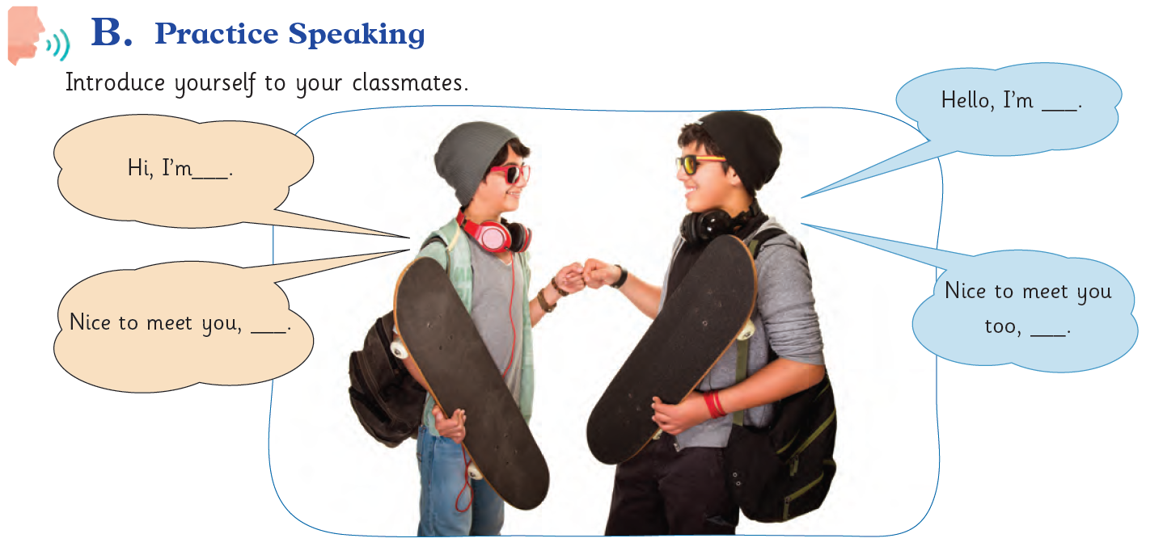


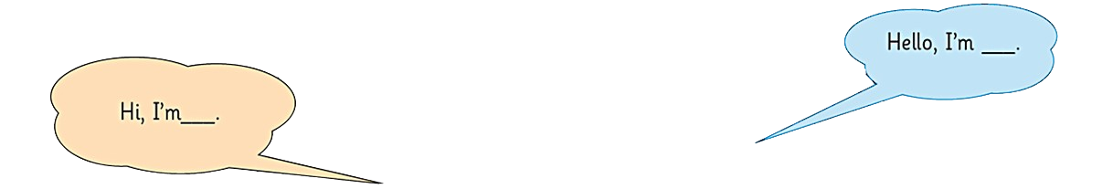
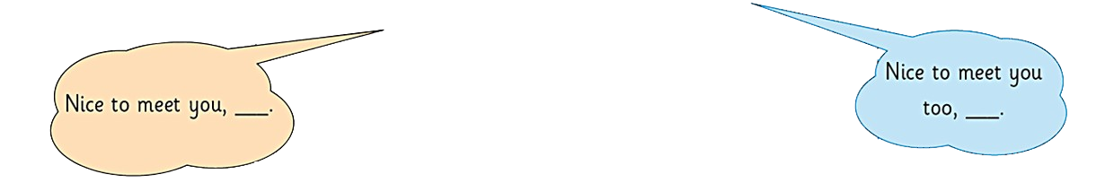

Slide 5


Slide 6
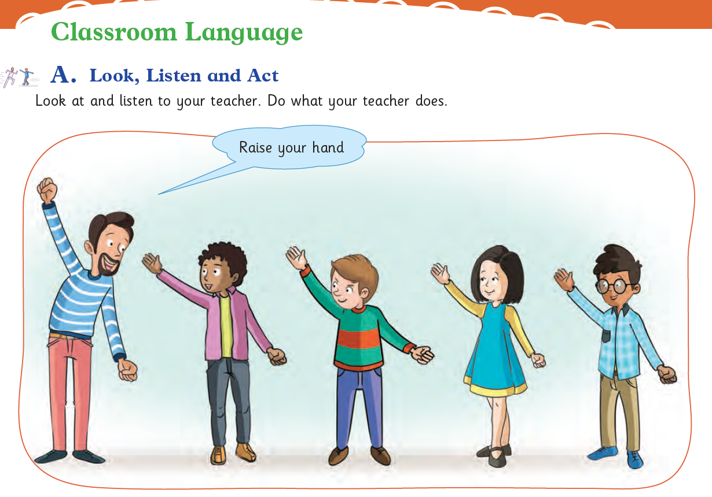

Slide 7
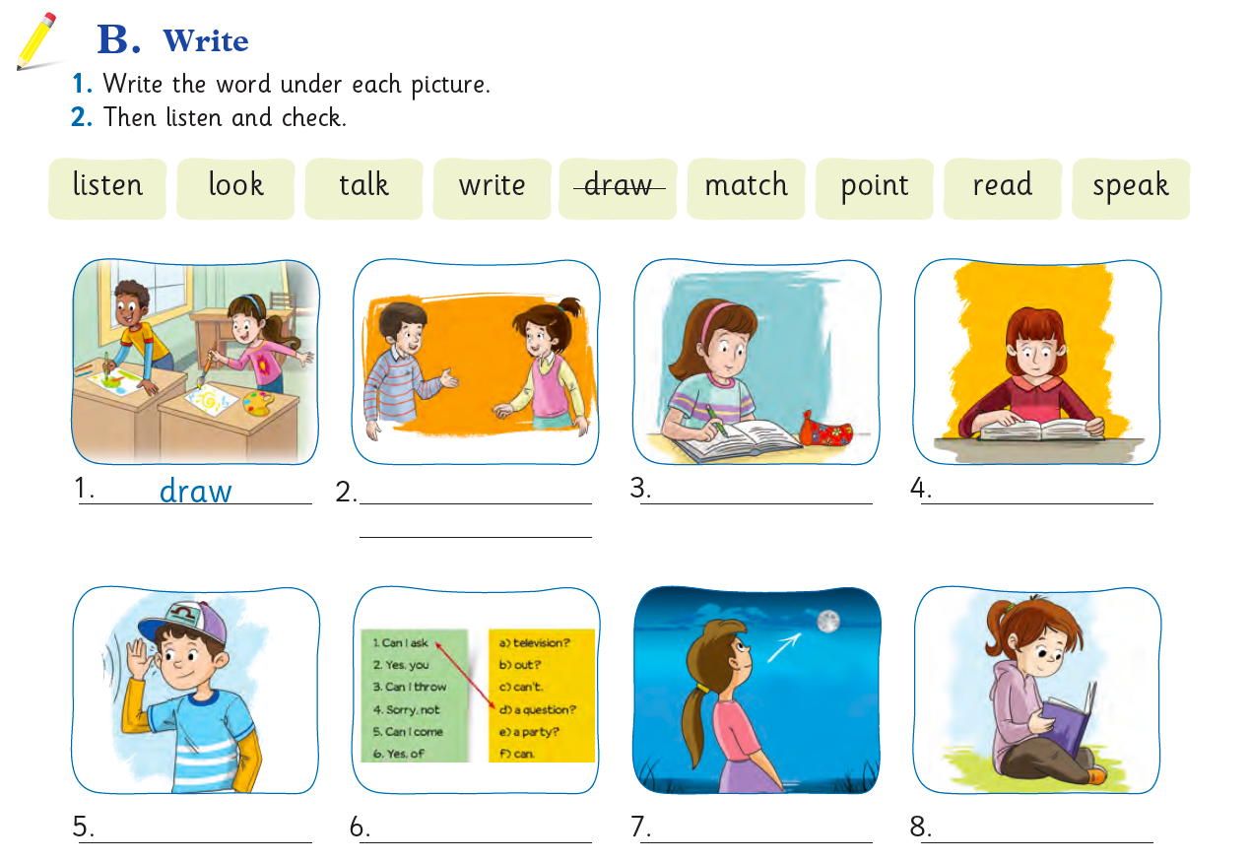


speak
write
point
talk
listen
match
look
read

Slide 8
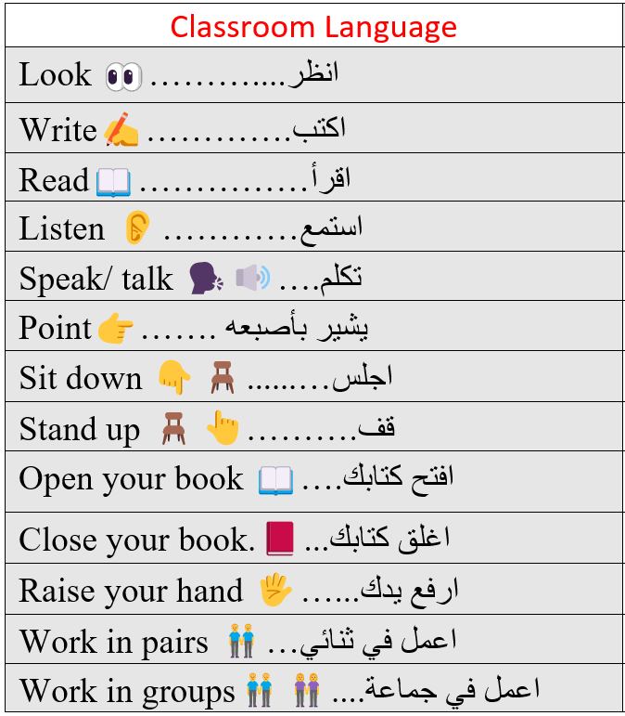

Slide 9
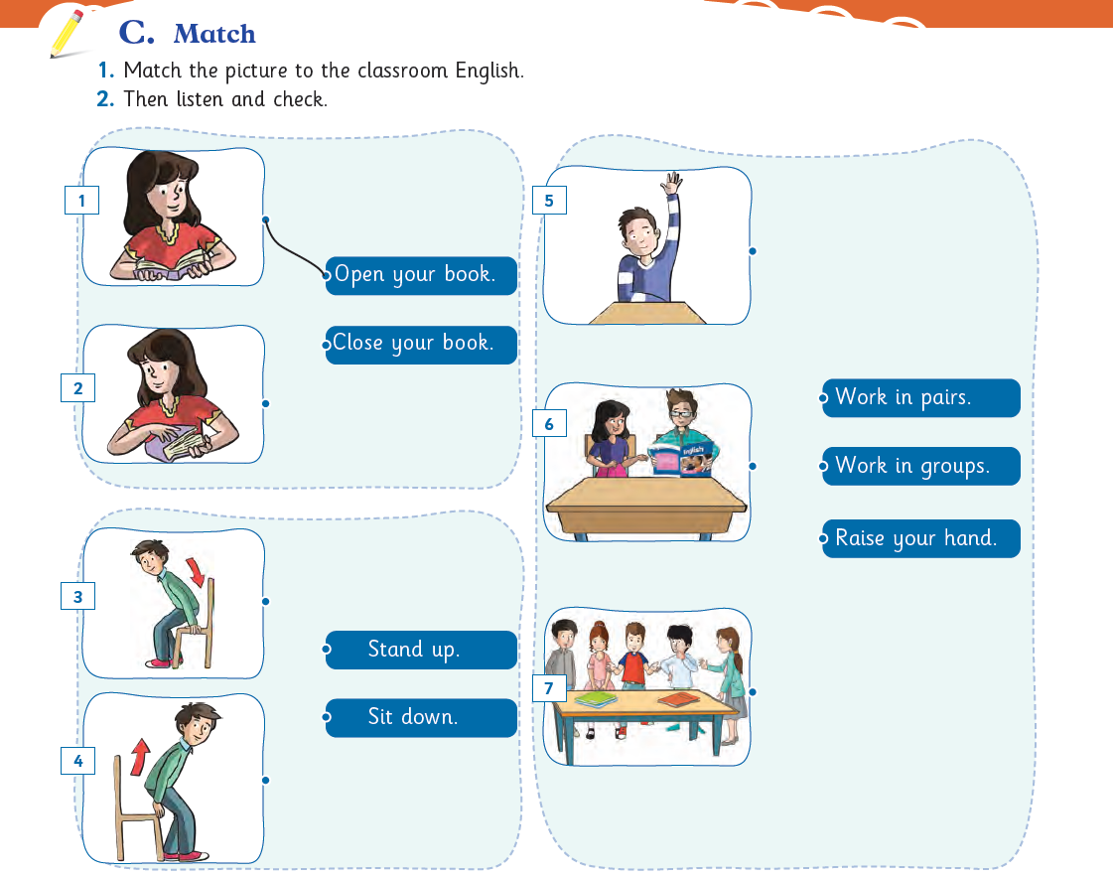

Slide 10
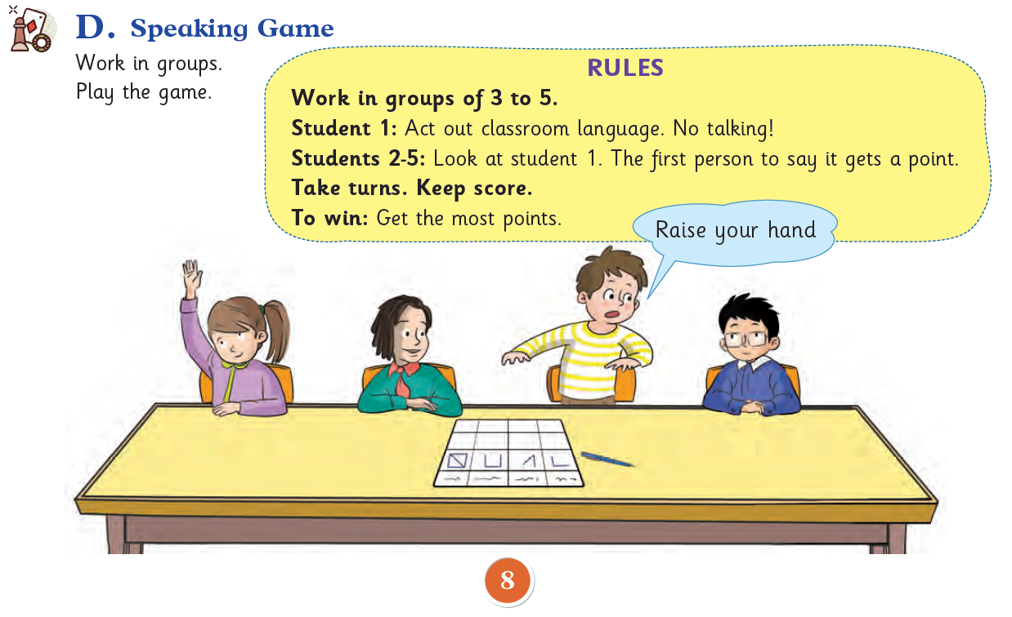

Slide 11
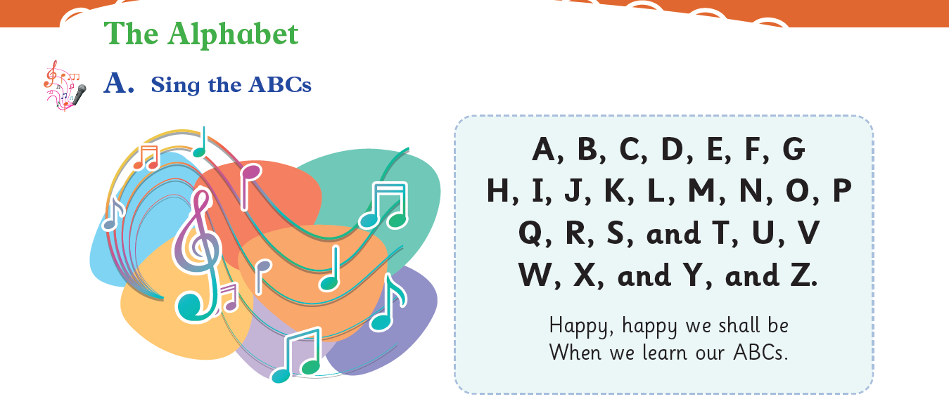

Slide 12
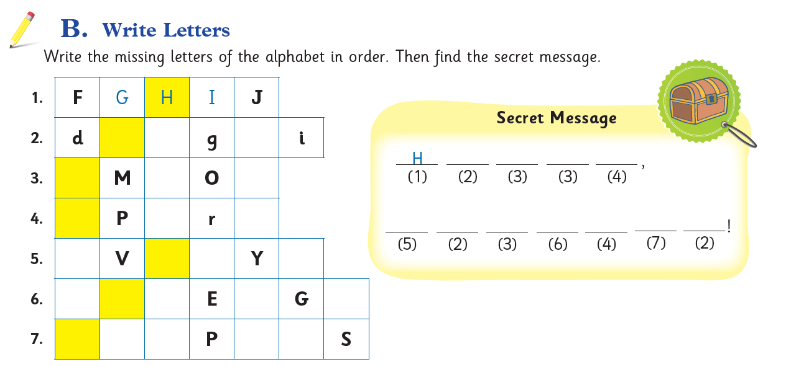
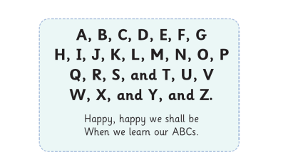
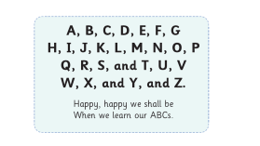
e
f
h
e
l
l
o
L
N
p
O
q
s
W
e
l
c
o
m
e
U
W
X
Z
B
C
D
F
H
M
N
O
Q
R

Slide 13
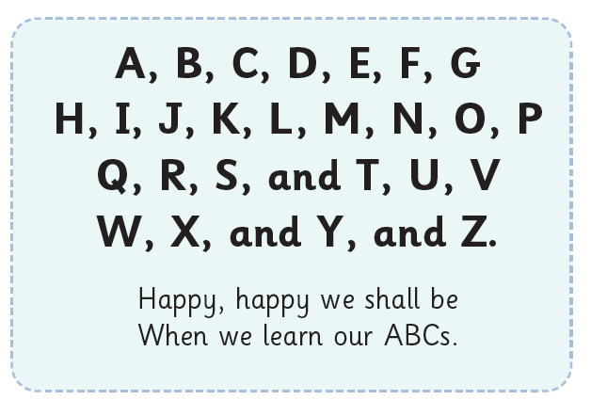

Slide 14
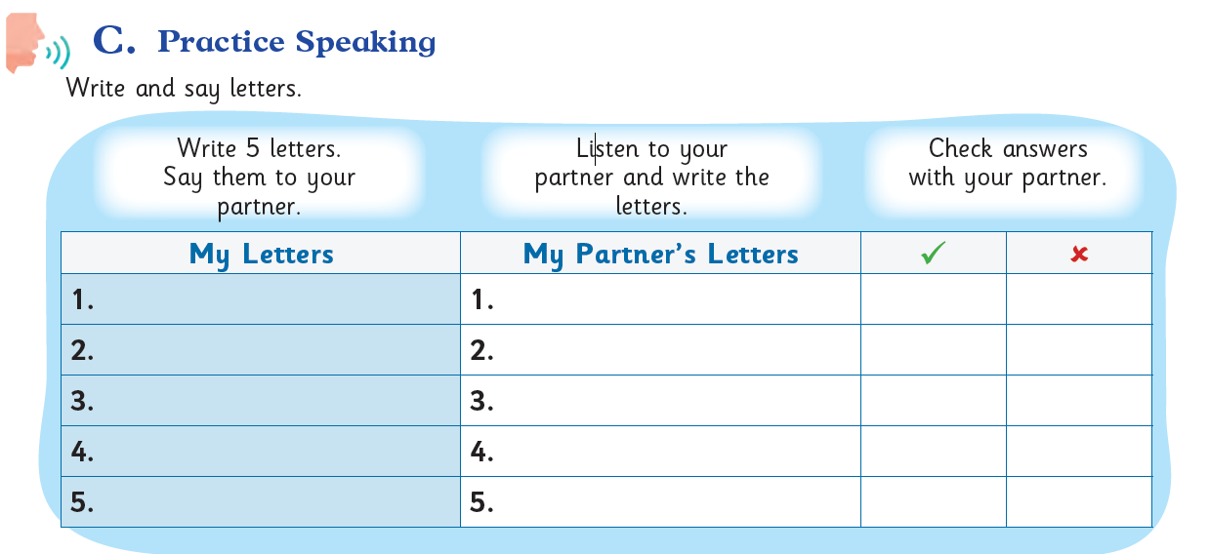

Slide 15


Slide 16
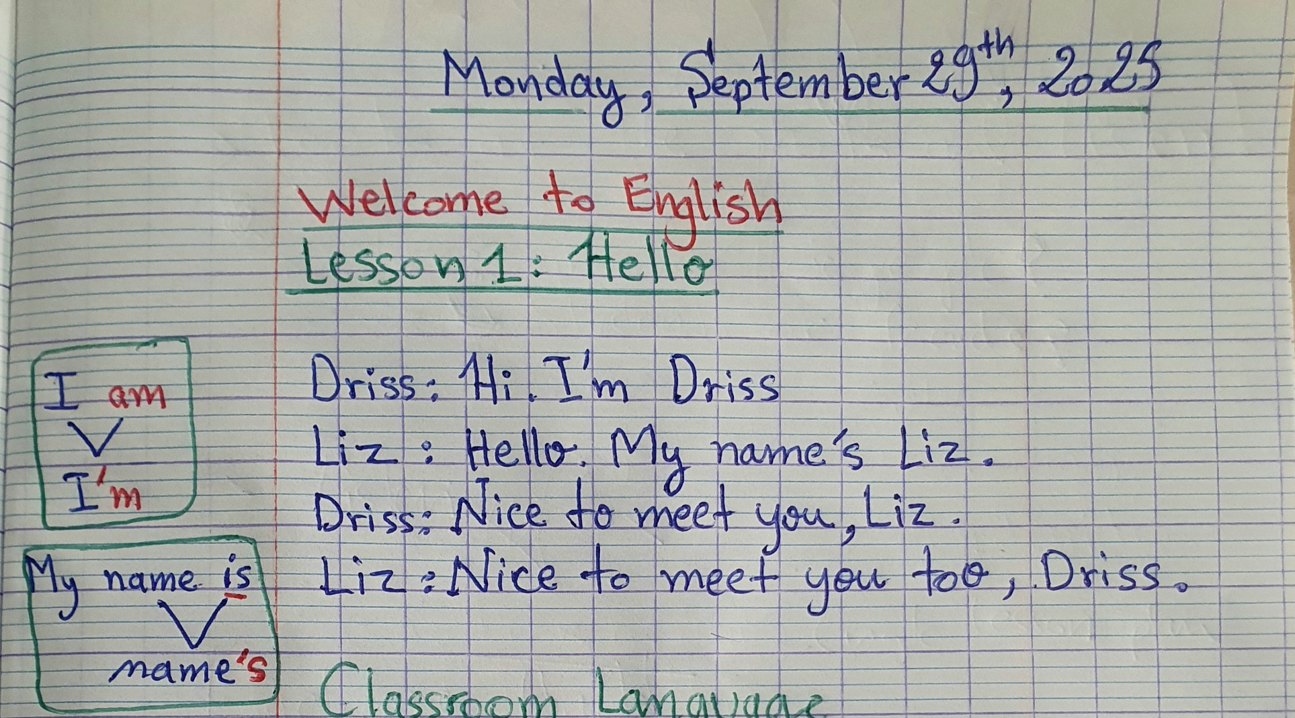


Slide 18
