Slide 1

UNIT 1 • MYSELF & OTHERS
LISTENING
My Favourite Things

Slide 2
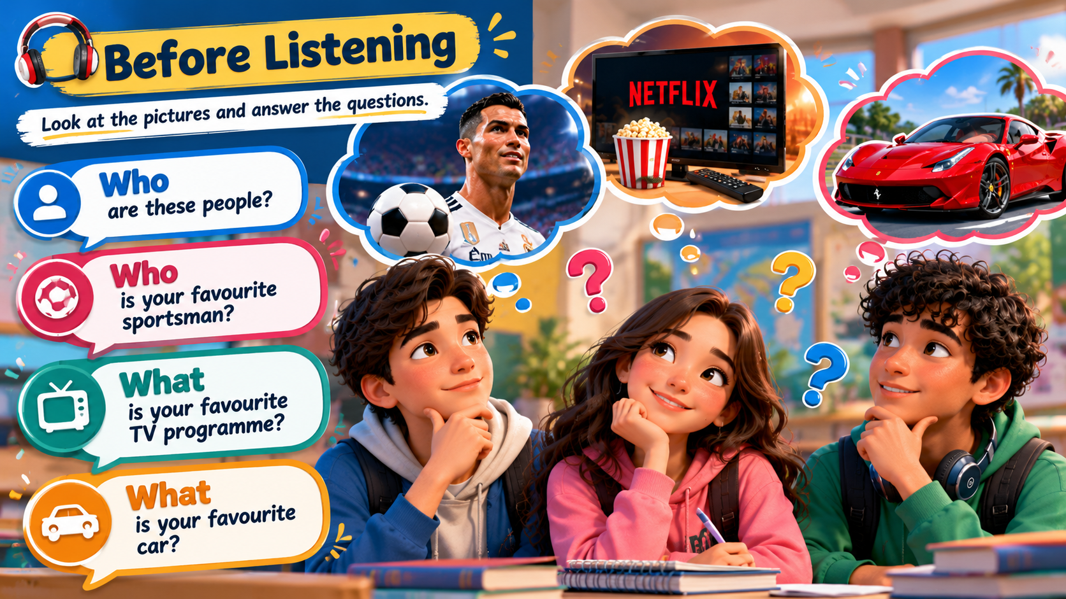
PRE-LISTENING
UNIT 1 • MYSELF & OTHERS
Look & Predict
SPORTS
Who is your favourite football player?

Slide 3
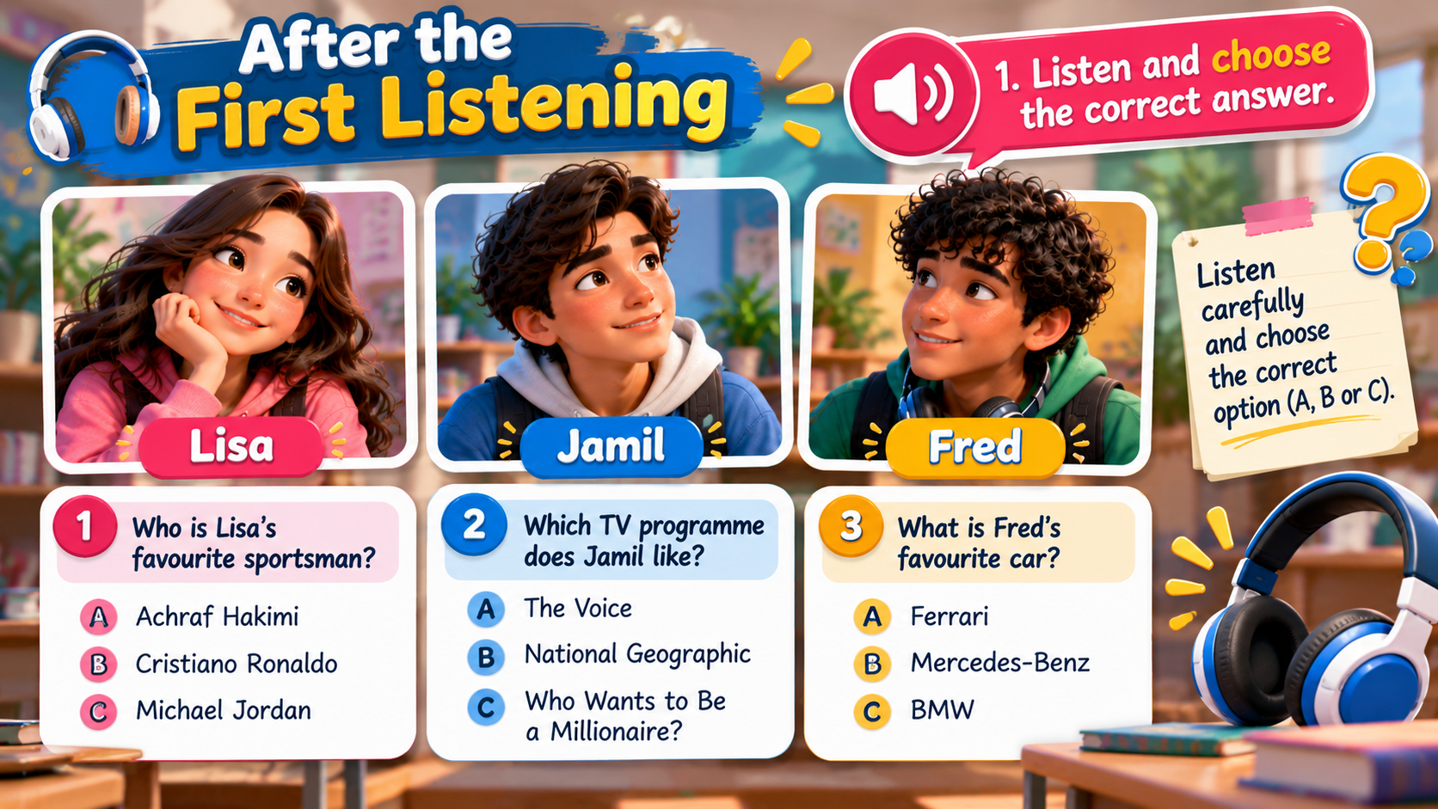


Slide 4
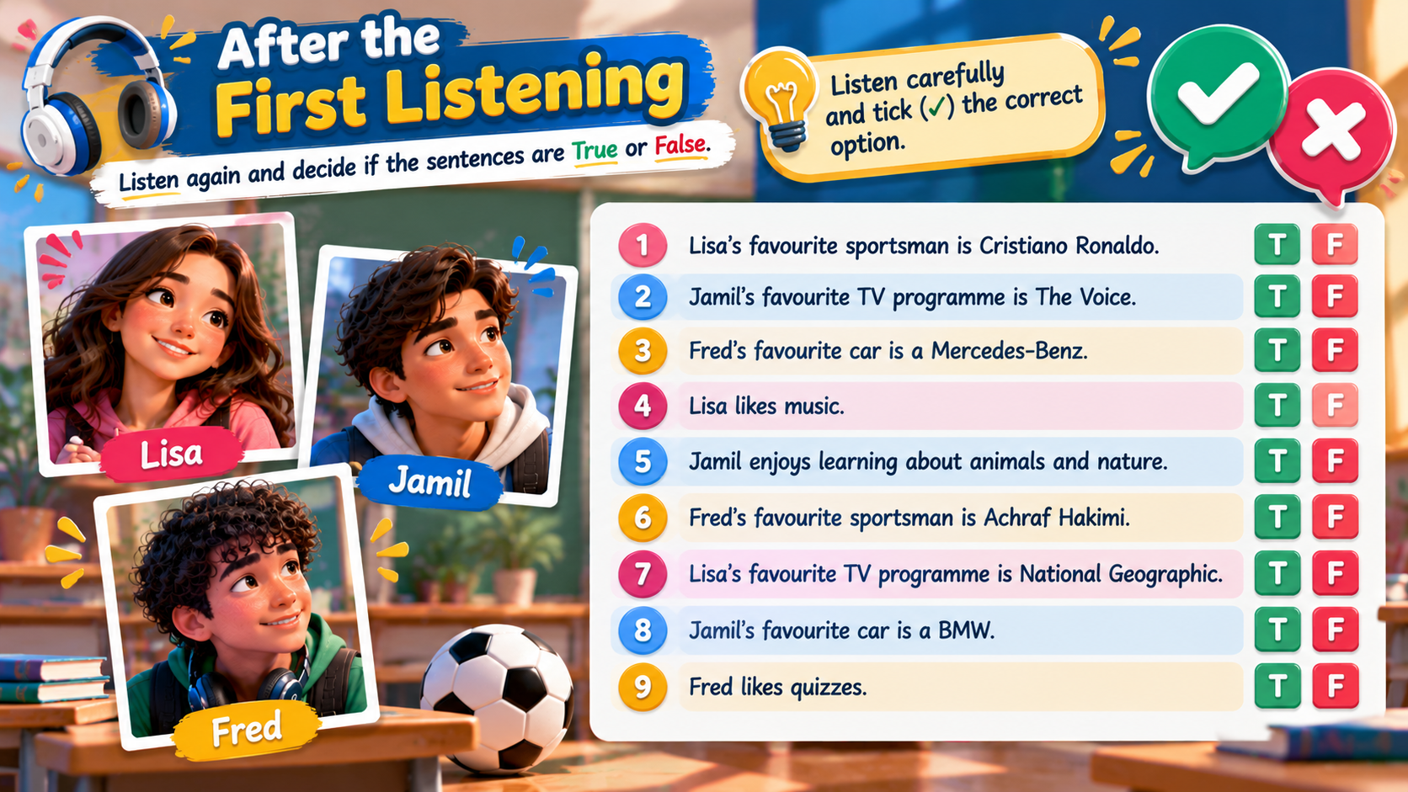

Slide 5
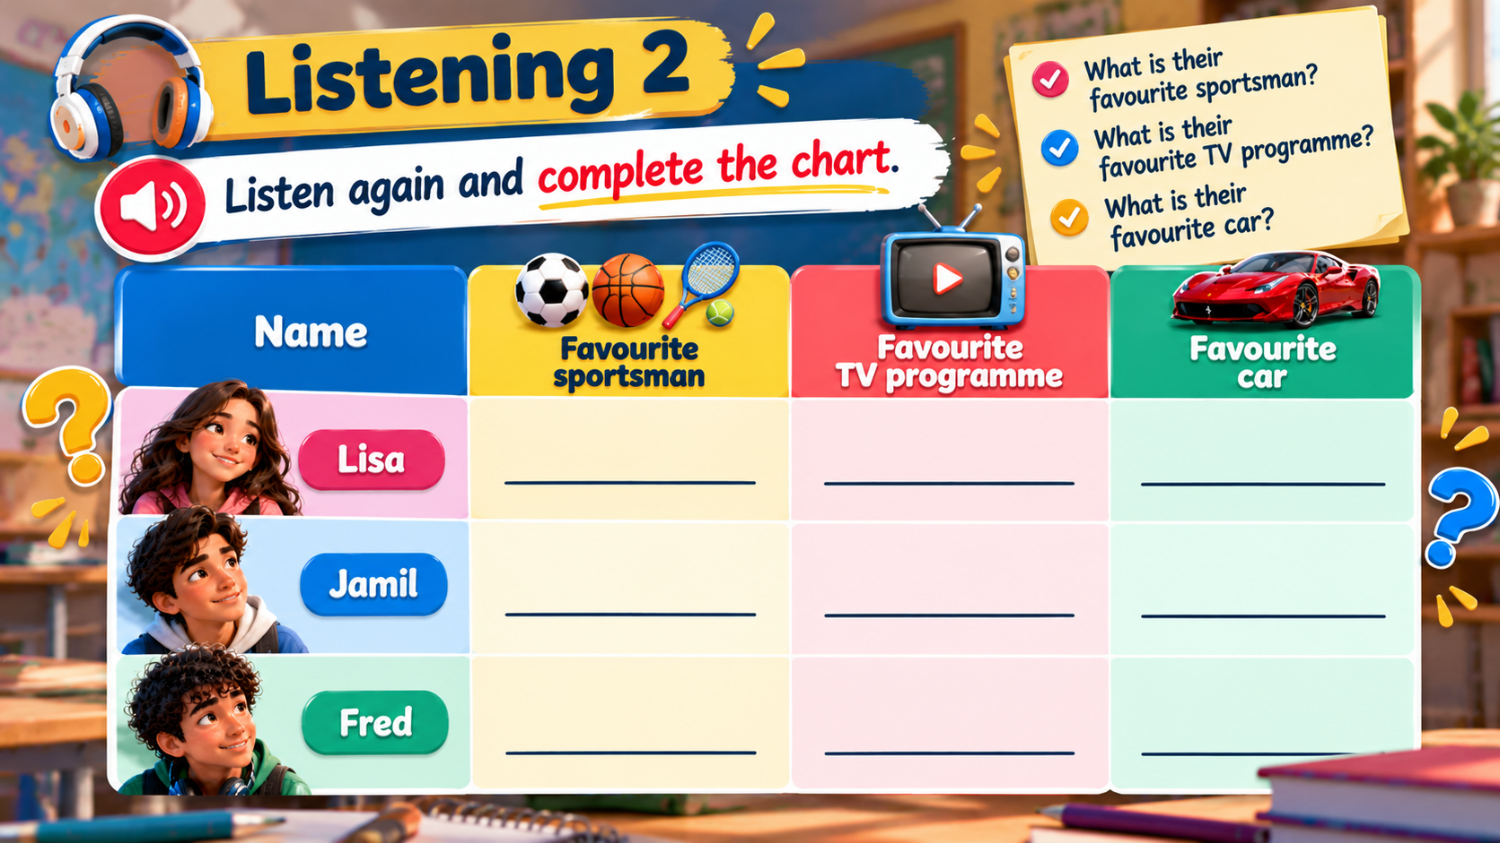
Cristiano Ronaldo
The Voice
Ferrari
National Geographic
Achraf Hakimi
Mercedes-Benz
Who Wants to be A Millionaire
Michael Jordan
BMW

Slide 6
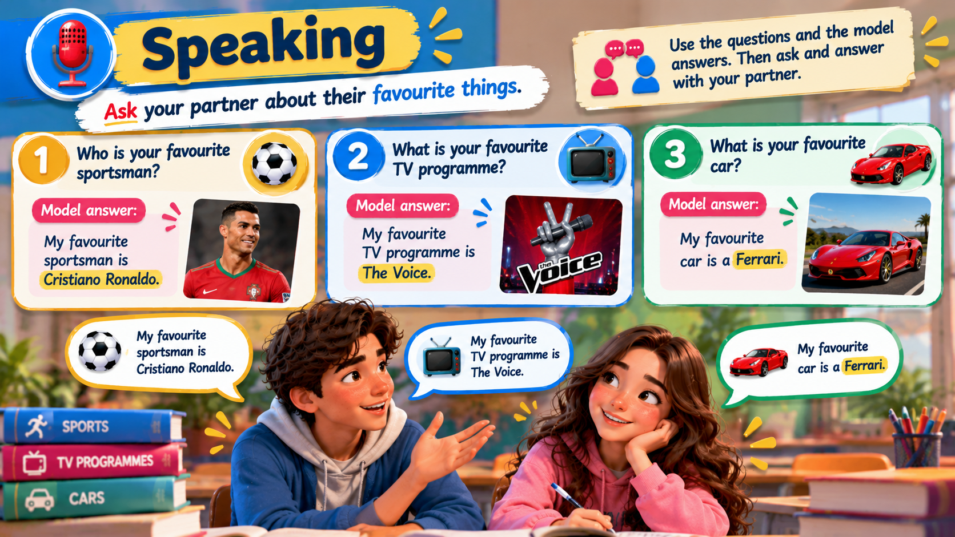
SPEAKING
UNIT 1 • MYSELF & OTHERS
Ask your partner
Find out your partner’s favourite things.
SPORTS
TV
CAR
Who is your favourite sportsman?
My favourite sportsman is …
What is your favourite TV programme?
My favourite TV programme is …
What is your favourite car?
My favourite car is …
Student A asks. Student B answers. Then change roles.

Slide 7
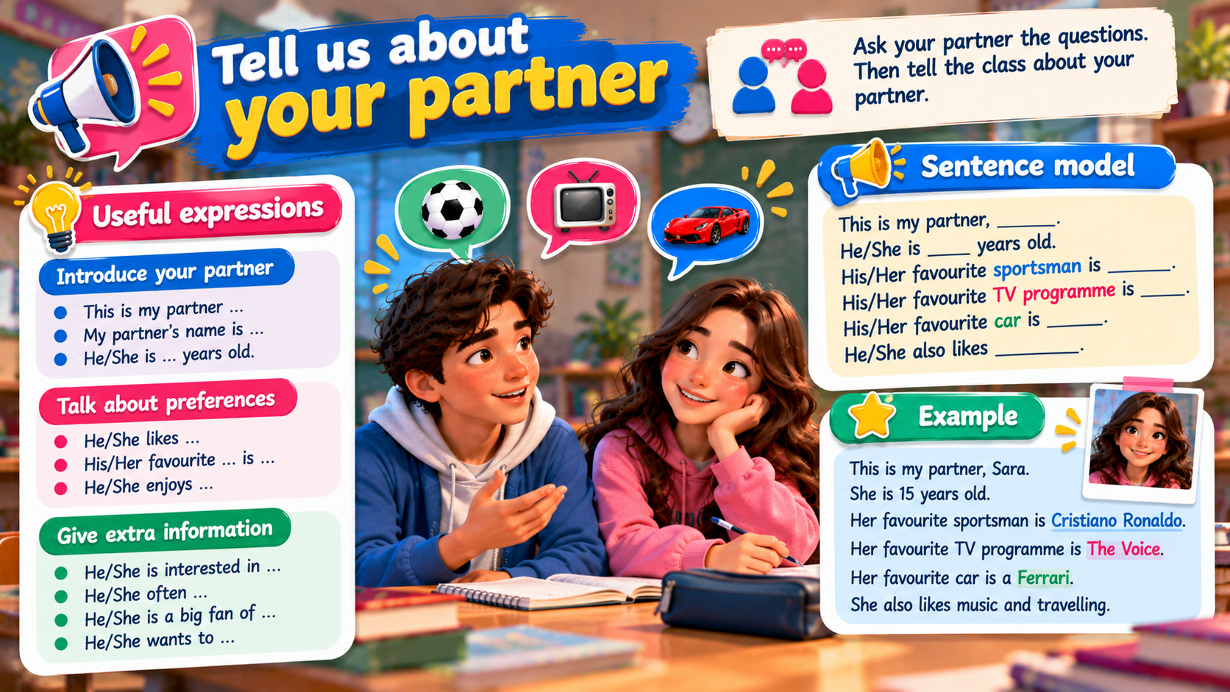
SPEAKING
UNIT 1 • MYSELF & OTHERS
Tell us about your partner
Report three pieces of information.
My partner’s favourite sportsman is ____________.
His/Her favourite TV programme is ____________.
His/Her favourite car is ____________.
Use “his” for a boy/man and “her” for a girl/woman.

