Slide 1

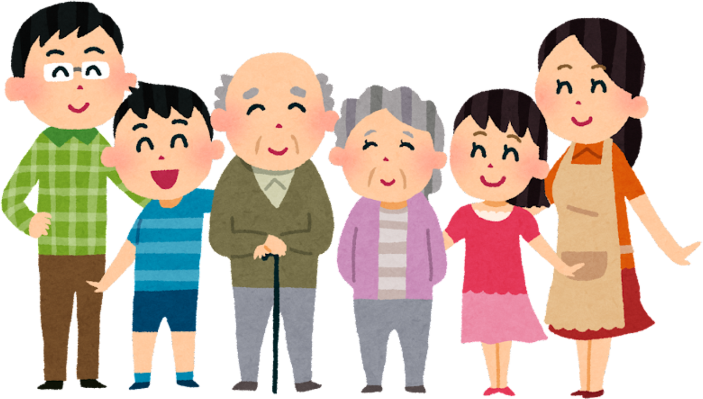
GET TO KNOW OUR
family members

Slide 2
Sara: Do you have a big family, Karim?
Karim: Yes, I do. I live with my parents and my two sisters.
Sara: Oh nice! What’s your father’s name?
Karim: My father’s name is Hassan.
Sara: And your mother?
Karim: Her name is Fatima.
Sara: Do you have any brothers?
Karim: No, I don’t. I only have sisters.
Sara: I see. My family is small too. I live with my mother and my brother.
Karim: What is your brother’s name?
Sara: His name is Youssef.
Let’s check your understanding:
Does Karim have a big family or a small family?
How many sisters does Karim have?
Does Sara have a brother or a sister?

Slide 3
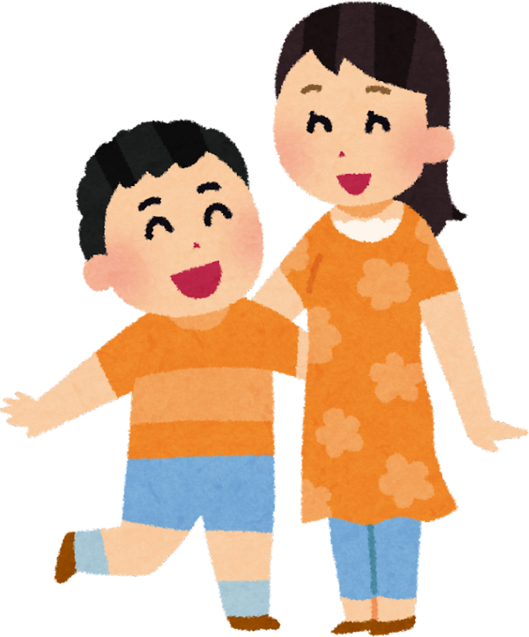
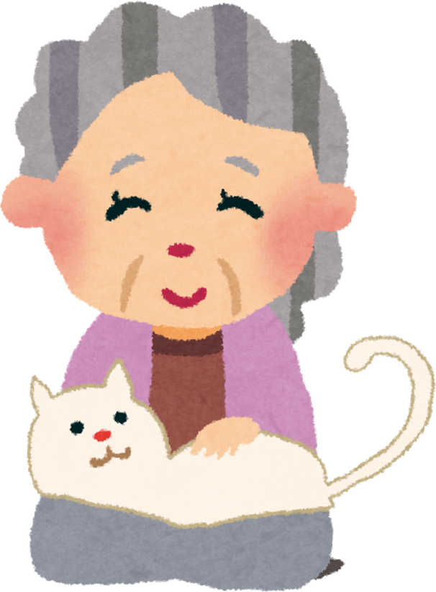
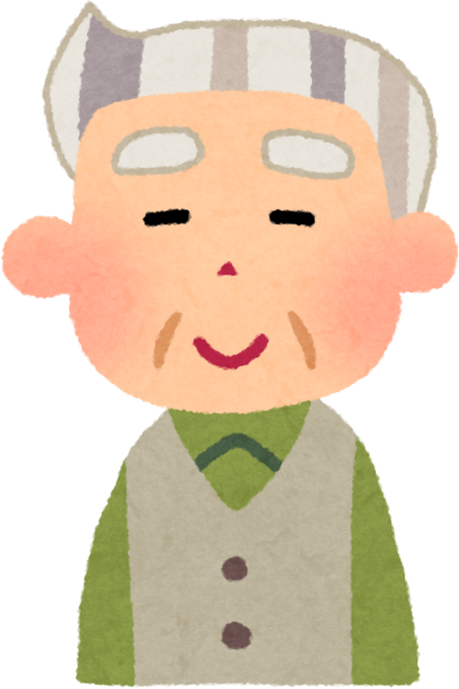
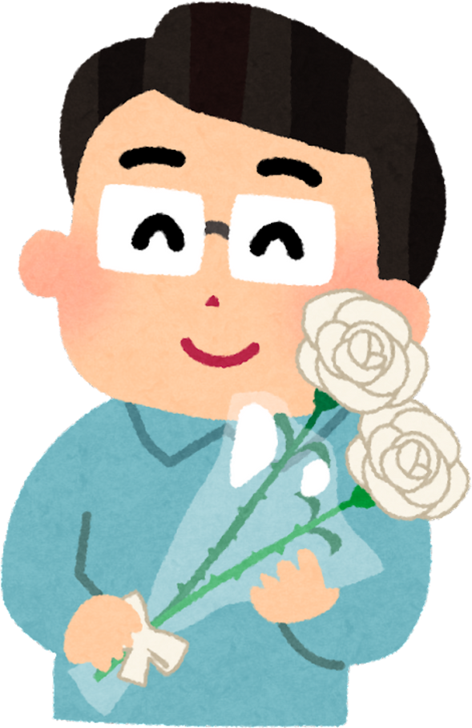

Family

Slide 4
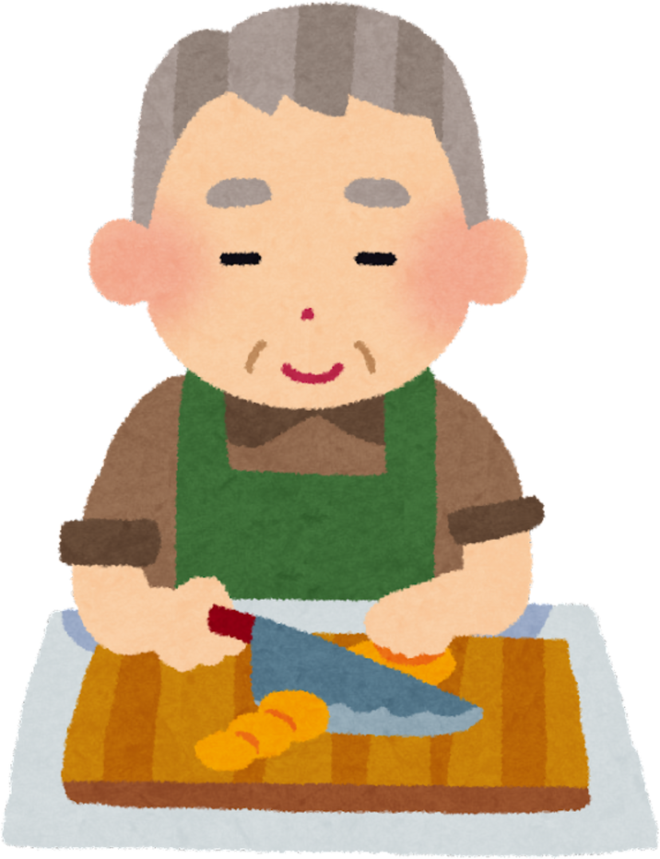
Grandfather

Slide 5
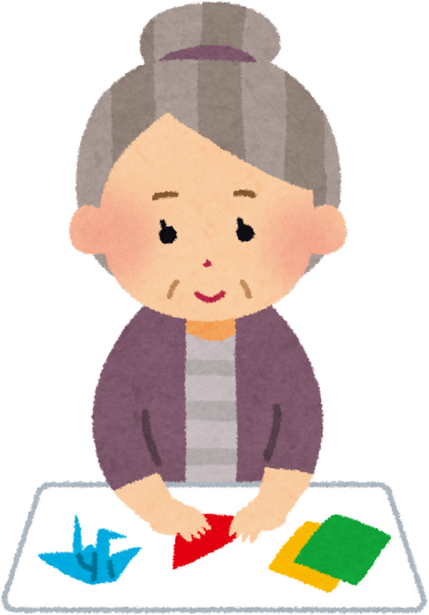
Grandmother

Slide 6

Mother

Slide 7

Father

Slide 8
Sister

Slide 9
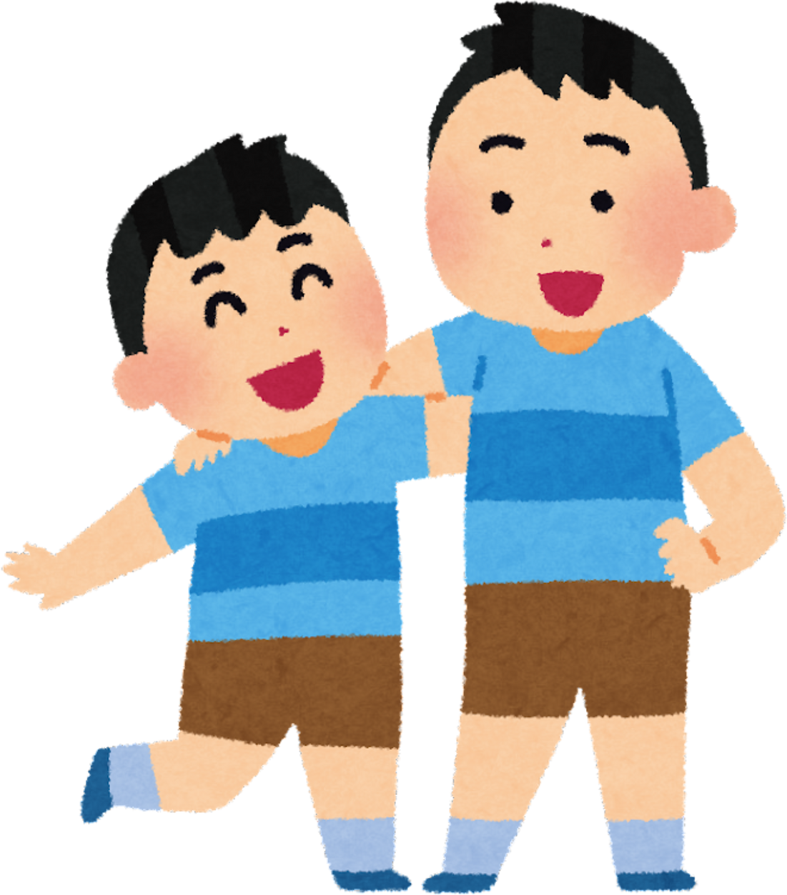
Brother

Slide 10
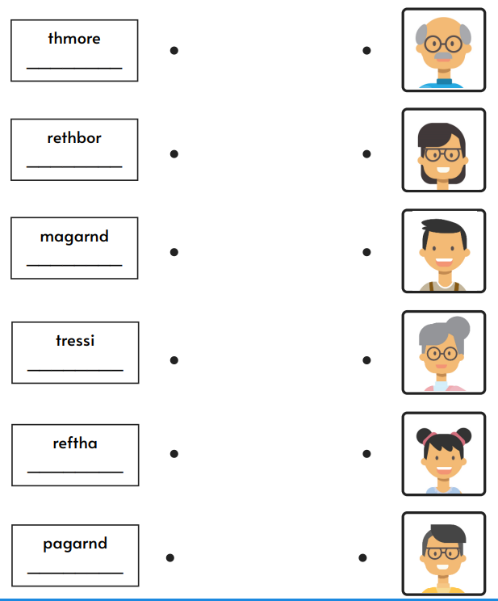
morgnadthde
afagrndthde

Slide 11
Task 1: Choose the correct answer.
(His / Her/My) name is Fatima. She is my friend.
Omar loves (his / her/my) new phone.
I’m Mohamed.(her/my / his) parents are teachers.
Look at Salma. Is that (his / her/my) name?
This is Hassan.(her/my / his) father is a mechanic.

Slide 12
Family tree
Aisha
( grandmother)
Ahmed
( grandfather)
Fatima
( mother)
Mohamed
( father)
Imad
( brother)
Me
Yassmine
( sister)

Slide 13
Tell your partner about your family:
This is my family.
This is my mother. Her name is -----------------------
This is my father. His name is --------------------------
This is my sister. Her name is -----------------------------
This is my brother. His name is ---------------------------
This is my grandmother. Her name is -------------------------
This is my grandfather. His name is ----------------------------

Slide 14
My Family tree
Me

Slide 15
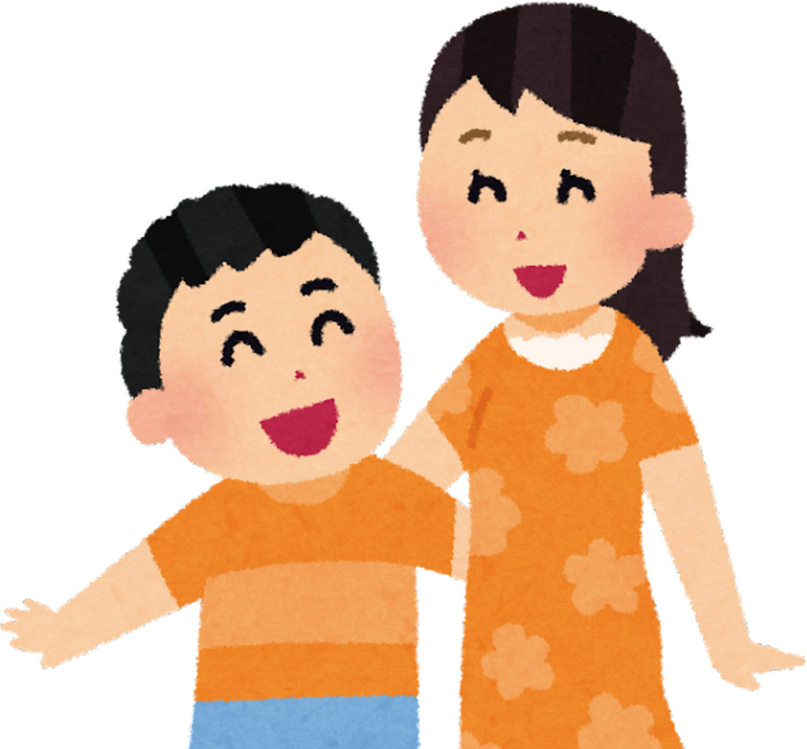
Monday, October 05th , 2026
Unit 1: Lesson 4 Meet My Family
Write the missing words:
A: Do you have a sister?
B: Yes, I ____ .
A: what’s your sister’s name?
B: Her name is _____________
A: How do you spell that?
B: __________________
A: __________________ ?
B: She’s _____________ years old.
A: What grade is she in?
B: She’s in year ___ of ______________ .
A: _________________ a brother?
B: No, I_________.

Slide 16
Unit 1:
Lesson 4 Meet My Family
Monday, October 05th , 2026
Yassine: Do you have a sister?
Salma: Yes, I do.
Yassine: what’s your sister’s name?
Salma : Her name is Asmae
Yassine: : How do you spell that?
Salma : A-S-M-A-E
Yassine: How old is she ?
Salma: She’s 15 years old.
Yassine: What grade is she in?
Salma: She’s in year 1 of Middle school .
Yassine: Do you have a brother?
Salma : No, I don’t.

